Slide 1
Elevator Simulation
Madhumitha R
1NH16CS745
CSE Dept

Slide 2
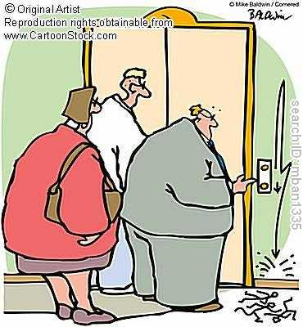
INTRODUCTION
  Simulation is a way of developing application or design simulating real world, the way which help in clarifying the real idea.
Goal:
  Analysis of possible elevator scheduling algorithms through simulation
  Find most optimal in given problem
  Suggest future directions

Slide 3
OOPS Concepts Used

Slide 4
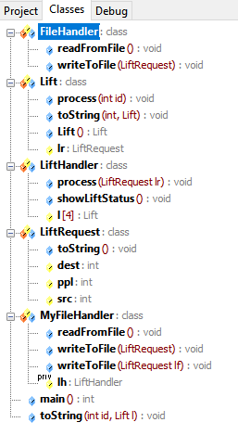
CLASSES AND OBJECTS
Objects are the real time entities such as table, chair, building etc. Objects are the blueprints of the classes.
The project has used 5 classes:
  class LiftRequest
  class Lift
  class LiftHandler
  class FileHandler
  class MyFileHandler : public FileHandler

Slide 5
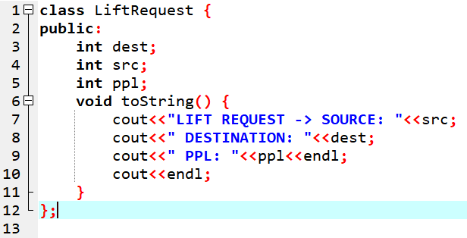
ENCAPSULATION
  All the classes created have data members and member functions binded together into a single unit.
  Thus every object created will have an instance of all those data members and member functions.

Slide 6
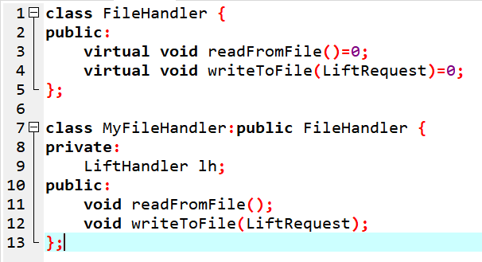
INHERITANCE
  Inheritance is the process of inheriting properties of objects of one class by objects of another class.
  In this project, the concept of Single Inheritance has been used.
  When a single class is derived from a single parent class, it is called Single inheritance.
  Base Class-
    class FileHandler
  Derived Class-
    Class MyFileHandler

Slide 7
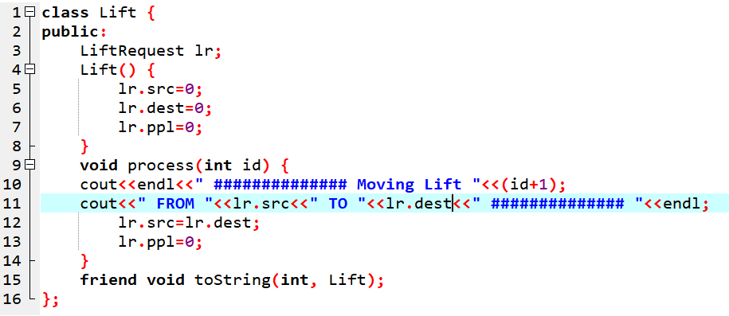
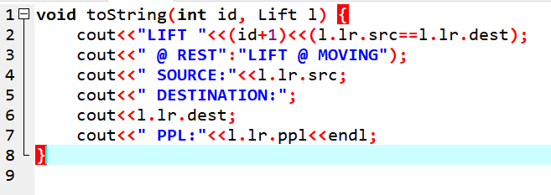
FRIEND FUNCTIONS
  Friend functions are the functions which are used to access the data members of a class and are not the member functions.
  Friend functions are only declared inside a class and are defined outside a class.

Slide 8
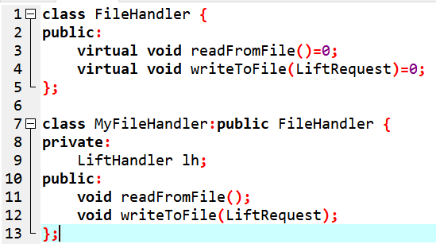
VIRTUAL FUNCTIONS
  A virtual function is a member function which is declared within base class and is re-defined (Overridden) by derived class.
  When you refer to a derived class object using a pointer or a reference to the base class, you can call a virtual function for that object and execute the derived class's version of the function.

Slide 9
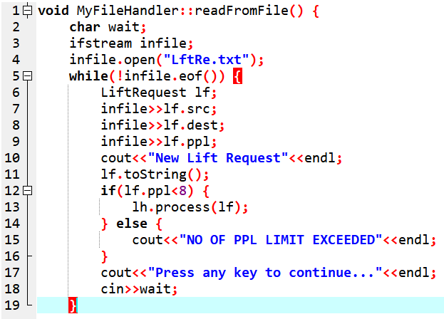
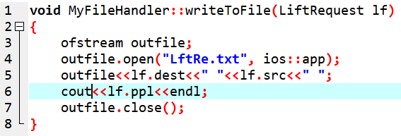
FILE HANDLING CONCEPTS
READ FROM A FILE
WRITE TO A FILE
ifstream
This data type represents the input file stream and is used to read information from files.
ofstream
This data type represents the output file stream and is used to create files and to write information to files.

Slide 10
SAMPLE OUTPUTS

Slide 11
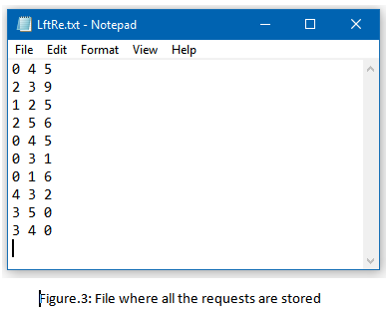
File where all the requests are stored

Slide 12
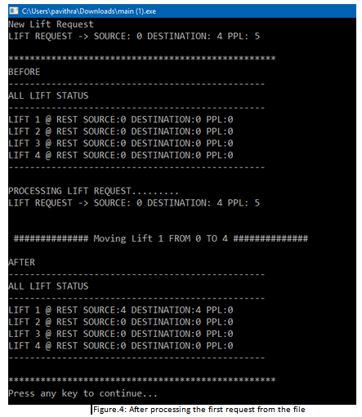
After processing the 1st request from the file

Slide 13
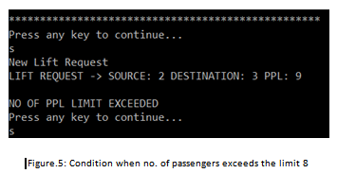
Condition when no. of passengers exceeds the limit 7

Slide 14
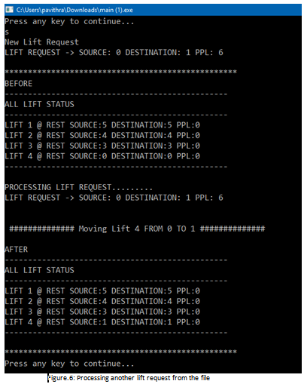
Processing another lift request from the file

Slide 15
SUMMARY
The elevator challenge was born out of a long time curiosity in the control of elevators.
Elevator simulation is becoming increasingly more flexible and powerful.
Elevator simulation models of varying sophistication have been written and applied for many years.
The continuing improvements in computer technology and software development tools make increasing complex and comprehensive simulation models feasible.

Slide 16
Thank You!

